Slide 1

Depression:
The Facts
Grades 10–12
Together For Health

Slide 2
17%
of youth aged 15–24 in Canada experience a depressive episode (CMHA)
Depression is the leading cause of disability worldwide for ages 15–44.
Together For Health

Slide 3
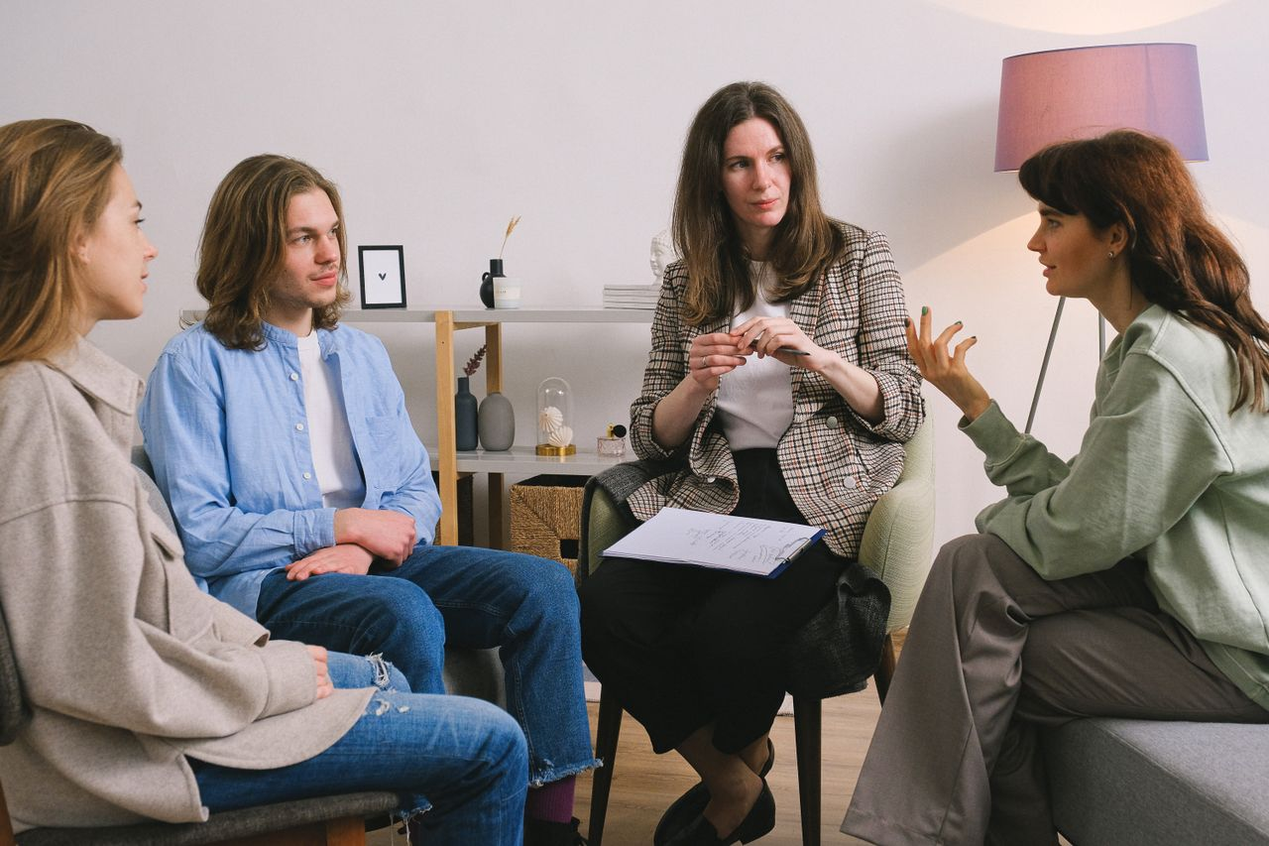
🧠
The Neuroscience of Depression
Depression involves reduced activity in prefrontal cortex and hippocampus
Stress hormones like cortisol can damage the hippocampus over time
Serotonin, dopamine, and norepinephrine are all implicated
Brain imaging shows real structural differences in depressed individuals
This is why "just think positive" does not work — the brain is literally different
Together For Health

Slide 4
🚨
Warning Signs of a Depressive Episode
Pervasive low mood lasting 2+ weeks
Anhedonia: inability to feel pleasure in previously enjoyed activities
Significant changes in sleep and appetite
Difficulty concentrating, making decisions, or remembering things
Thoughts of worthlessness, hopelessness, or death/suicide
Together For Health

Slide 5

🏥
Types of Treatment — What Actually Works
Cognitive Behavioural Therapy (CBT) — gold standard for teens
1
Interpersonal Therapy (IPT) — focuses on relationships
2
Antidepressants — SSRIs, can be very effective (takes 4–6 weeks)
3
Exercise: proven as effective as medication for mild-moderate depression
4
Sleep hygiene and routine — foundational for recovery
5
Together For Health

Slide 6
🛑
Suicide Risk — Know the Signs
Depression is the #1 risk factor for suicide. Never ignore warning signs.
If someone talks about wanting to die, gives away possessions, or says goodbye — act immediately. Call 9-8-8.
Together For Health

Slide 7
KEY TAKEAWAYS
Depression is a medical condition — treat it like one
✓
Asking for help is not weakness — it is self-awareness
✓
Early treatment prevents depression from becoming chronic
✓
Resources
Suicide Crisis Helpline: 9-8-8 (call or text)
Kids Help Phone: 1-800-668-6868
Psychology Today therapist finder: psychologytoday.com
Together For Health

